Slide 1


Data Governance @ SneakerPark
Prepared by: Mateus Leao
Submitted on: April 2021

Slide 2
Background
SneakerPark is an online shoe reseller that allows people to buy and sell used and new shoes. Buyers can bid for shoes or buy them outright, and sellers can set a price or sell to the highest bidder.
Each buyer and seller must have an active account in order to sell, bid, or purchase sneakers using SneakerPark’s website.
SneakerPark authenticates the shoes before shipping them to the buyer, so before listing an item, the seller must ship it to SneakerPark’s warehouse. Upon receipt, SneakerPark assigns an item number to each pair of sneakers and notifies the seller that they are now free to list their item. If the item is not listed within 45 days, SneakerPark returns it to the seller and sends an invoice to the seller for the shipping cost.
If the item is found to be inauthentic or in an unacceptable condition, it is also returned back to the seller in a similar fashion.
When the item sells, the buyer’s account is credited with the purchase price minus the SneakerPark service fee and shipping fees to deliver the item to the buyer.
Currently, SneakerPark only supports sales within the United States.

Slide 3
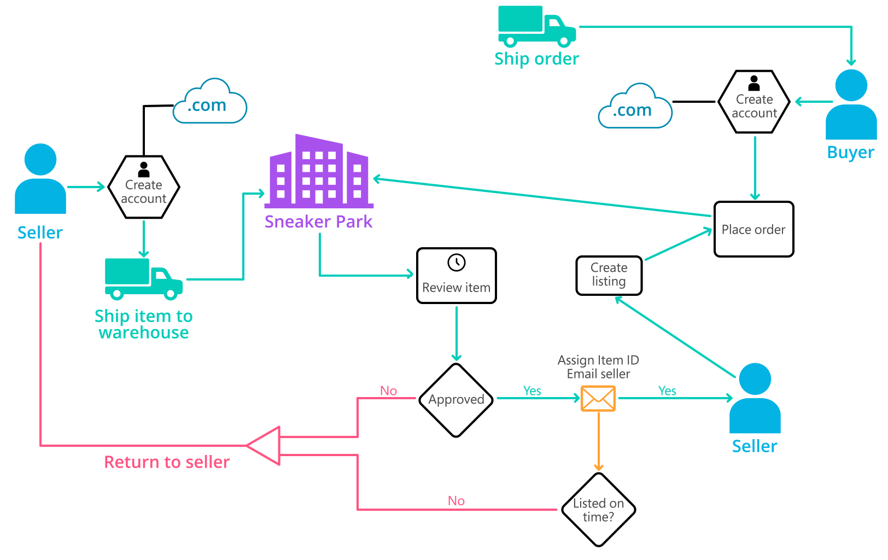
Background (cont’d)
Below you can see a diagram that will hopefully help you visualize some of SneakerPark's business processes. Keep in mind that it does not capture ALL processes and every nuance, but simply serves as another artifact to use in your project.

Slide 4
Step 1
Enterprise Data Catalog Part 1: Enterprise Data Model

Slide 5
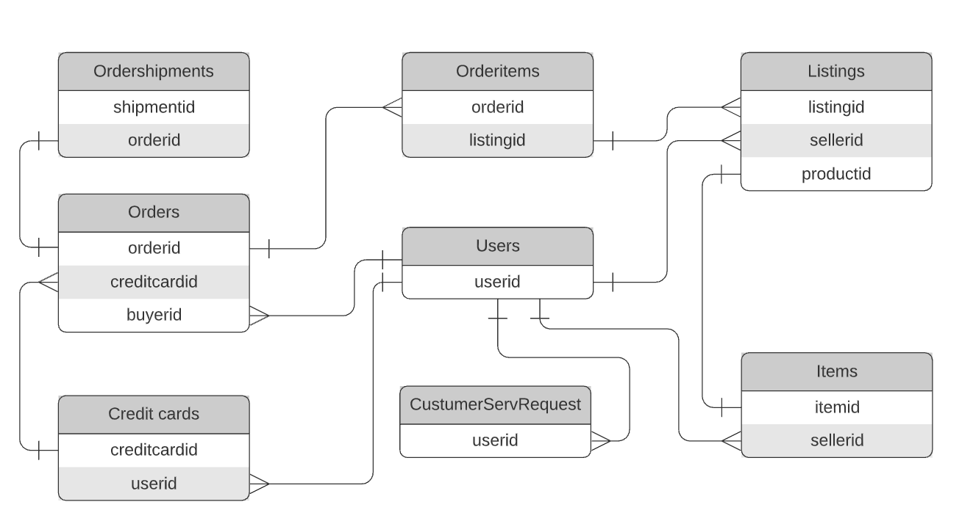
Replace the example below with your own solutions:

Slide 6
Step 2
Enterprise Data Catalog Part 2: Metadata
Results are in the Excel File

Slide 7
Step 3
Data Quality
Part 1: Profiling and Cleansing
Results are in the Excel File

Slide 8
Step 4
Data Quality
Part 2: Monitoring

Slide 9
Using the metrics you've created in the last step, please create a mock-up of a data quality monitoring dashboard that will be used to monitor the data to ensure compliance with your data quality rules:
Items being measured: % of Data filled (without nulls): Nulls %:
orders.shippingaddress 45%
items.itemstatus 2%
items.arrivaldate 2%
users.address 16%
65%
98%
98%
84%

Slide 10
Step 5
Master Data Management
Part 1: MDM Architecture

Slide 11
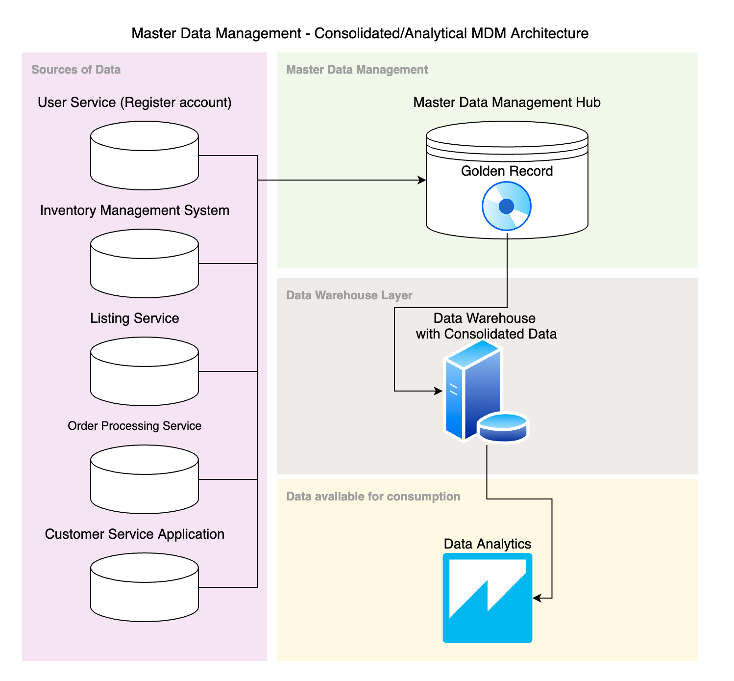
Master Data Management System and Short Explanation: How the current MDM Architecture affects the current systems? Answer: Since we proposed the consolidated/analytical MDM Architecture, which is not intrusive to our operational systems, the affect of our MDM architecture in the current systems architecture is minimal. We decided for this implementation because it is a robust solution that is simple to implement.

Slide 12
Explanation:
How the current MDM Architecture affects the current systems?
Answer:
Since we proposed the “consolidated/analytical MDM Architecture”, which is not intrusive to our operational systems, the effect of our MDM architecture in the current systems architecture will be minimal. We decided for this implementation because it is a robust solution that is simple to implement and give us enough advantages.
We will be able to have the Golden record where we can standardized and validate some important fields for our data model (user information is one of the data examples). This will be feed to our Data Warehouse where our data will be more consolidated.

Slide 13
Step 6
Master Data Management
Part 2: Master Record

Slide 14
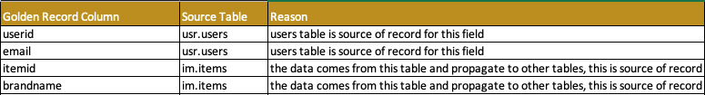
In this step, you will define a set of matching rules that will be used by the SneakerPark's MDM Hub to match item and customer entities between the company's different systems.
Please come up with 4 rules - 2 for Items and 2 for Customers and list them below.
Matching Rules:
Match users data on userid.
Match ítems data on itemid.
Additional Definitions of Golden Records:

Slide 15
Step 7
Data Governance:
Roles and Responsibilities

Slide 16
Write 1-2 paragraphs discussing what data governance roles and responsibilities will be necessary to oversee this new Data Management initiative.
Data Quality Management, Metadata Management, MDM, etc).
Data Governance Roles and Responsibilities –
We have Jake and Jessica as resources who can help us managing our Data. Jake is senior to Jessica, and Jessica has another responsibilities beyond data management and governance, besides that, the company will be hiring a junior resource to help with the necessary efforts, the intern will be under Jessica’s command.
Metadata Management: Even though Jessica is going to deliver this work to the new intern, it’s Jessica’s responsibility. All of the fields from our Database should be mapped with some basic description fields.
Data Quality Management & Monitoring Tools: Jake is responsible for this part, he’s responsible on assessing the quality of the data, and on making its quality increase be it with System changes or through talking with people and setting processes tp improve Data’s quality.
Data Lineage: Jake is responsible on designing Data Diagrams that explain Data Sources and Destinations so we can keep track of it.
Data Steward: The company need to hire an experienced data steward to lead the efforts in terms of Metadata and Master Data Management.

